Slide 1
Gold mine design
SEERA BHASKAR RAO
AP 20110010614

Slide 2
TABLE OF CONTENTS
Slide 3 : Problem statement
Slide 4 : Abstract
Slide 5 : Methodology
Slide 6-8: Implementation
Slide 9 : Main Code
Slide 10 : Output
Slide 11 : Observations

Slide 3
Problem Statement
Given a gold mine of n*m dimensions. Each field in this mine contains a positive integer which is the amount of gold in tons.
Initially, the miner is in the first column but can be in any row.
He can move only (right->, right up /, right down\) that is from a given cell, the miner can move to the cell diagonally up towards the right or right or diagonally down towards the right.

Slide 4
ABSTRACT
A proposition is a declarative statement that can be either true or untrue.
It is a method for expressing information logically and mathematically and offers techniques to combine or modify propositions in order to forge complex
structures and new logical relationships and features.
Gold mine design is a game in which the miner should collect max amount of gold in the allocated field.
As we aware that every game can be having some interesting rules and procedures.. This game is also having the same..

Slide 5
methodology
I implement this game design using Dynamic programming (Tabulation) which is used for storing the results start from low-level subproblem which is helpful to solve the next level sub-problem.
Here , we solve all the sub-problems iteratively.
It just updates its values in the form of a matrix in this game. And the code I am going to implement can reduce the time complexity with the help of the Tabulation technique.

Slide 6
Implementation
Initially a matrix with zeroes is created using the numpy library in which we can fill our own values(tons of gold) in the fields(rows and columns).
The below statements are the ways which are to be satisfied in the game.
We can’t move right if and only if we are at the last column.
We can’t move right up (/) if and only if we are in the first row or last column.
We can’t move right down (\) if and only if we are in the last row or last column

Slide 7
Implementation
Let’s consider,
R_{L} and R_{F} represent the Last and First rows respectively.
C_{L} and C_{F} represent the Last and First columns respectively.
Right represents R
Right up represents R/
Right down represents R\

Slide 8
Implementation
PROPOSITIONAL LOGIC STATEMENTS: -
C_{L} ←→ ~ R
(R_{F} v C_{L}) ←→ ~ R/
(R_{L} v C_{L}) ←→ ~ R\
By using these propositional logic statements, I am going to design the game in the form of a programming language but considering (L as F) and (F as L) because I am going to compare the next column with the previous column.

Slide 9
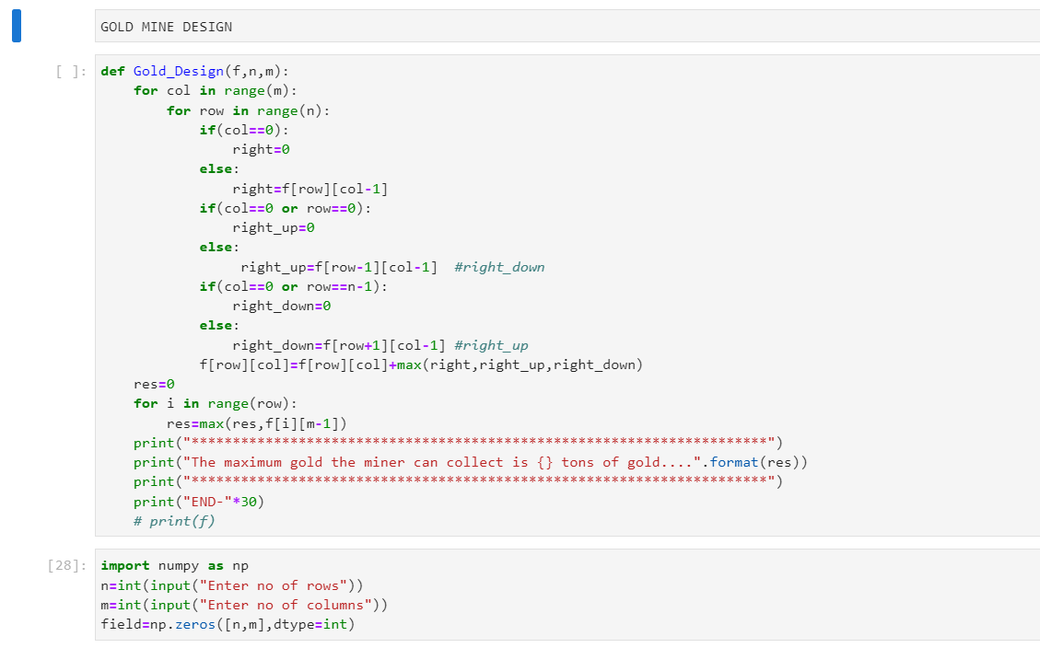
Main code
Tabulation of amount of gold for each field
Finding the max gold from the last column

Slide 10
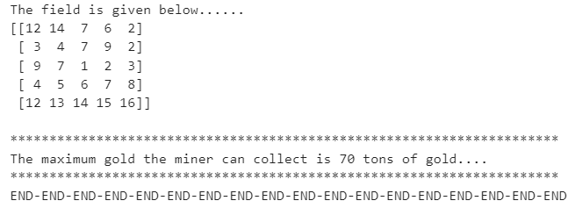

Slide 11
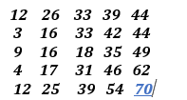
output

Slide 12
observations
We started from 1st column , for every column it checked maximum possible value with given conditions and it updated its value with the previous existing value in the same matrix.
As we moved on to the last column, the maximum possible values were updated in that column.
We found the maximum value from the last column using loop.

Slide 13
Thank you
Made by Bhaskar rao

